Slide 1
College Connect
Erin Colgrove, Jackson Tisler, Matt Betanski, Tyler Freeman

Slide 2
Premise
App designed to streamline the process of finding a college roommate
Future plans are to also include features such as connecting with others and finding/interacting with clubs
Similar to navigate app, but more geared toward the social aspect of college life

Slide 3
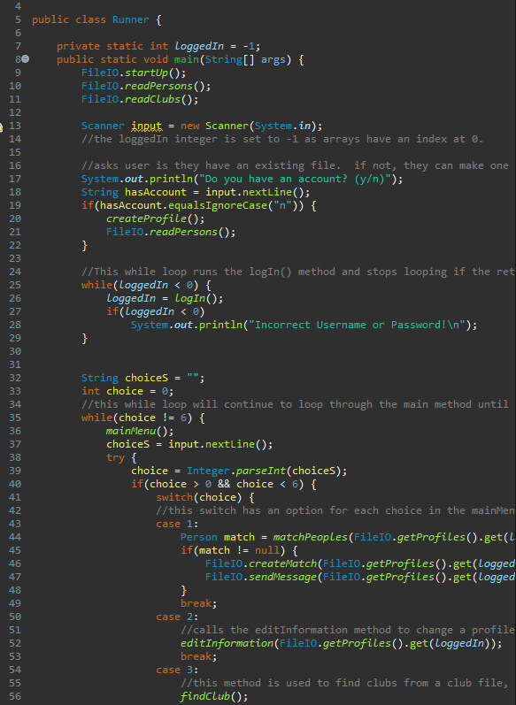
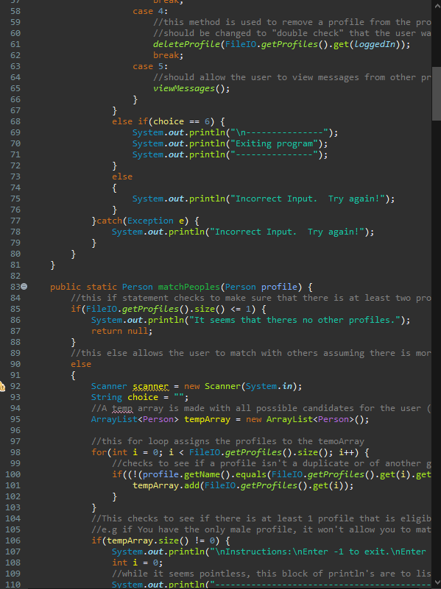
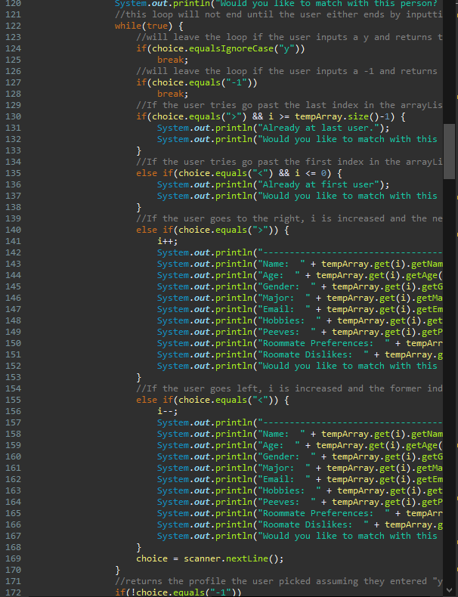
Runner

Slide 4
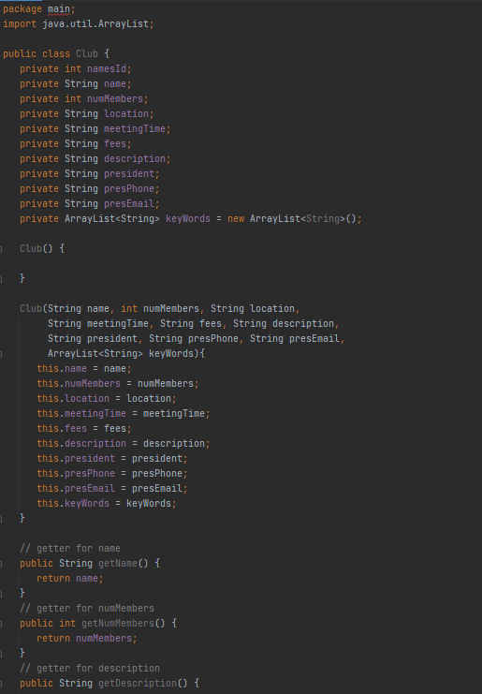
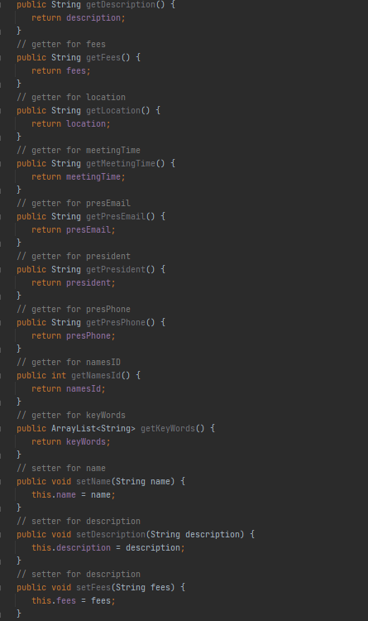
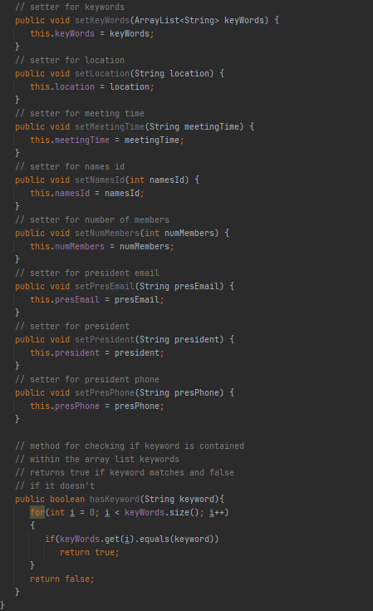
Club Class

Slide 5
FileIO
Handles the file structure and creating Person/Club objects
Consists entirely of static methods
startUp() method creates the necessary files right away during runtime if not already present
Stores files in USER/AppData/Roaming/CollegeConnect
Uses Scanner, File, and FileWriter to read and write to files

Slide 6
RunnerGUI
GUI part of the project
Multi-threaded
The main thread is what takes care of most of the functionality
The second thread only takes care of time-based updates, such as updating the messages in the FindRoommatePanel
Uses JFrame
Has lots of inner classes for the different panels and such shown
Utilizes reflection in some parts (wasn’t worth it)

Slide 7
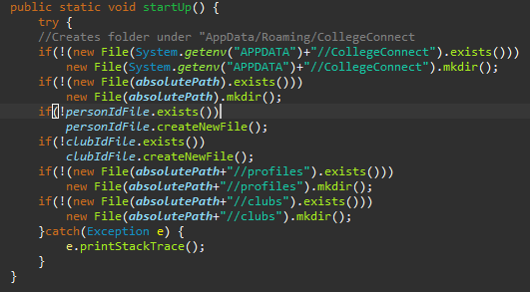
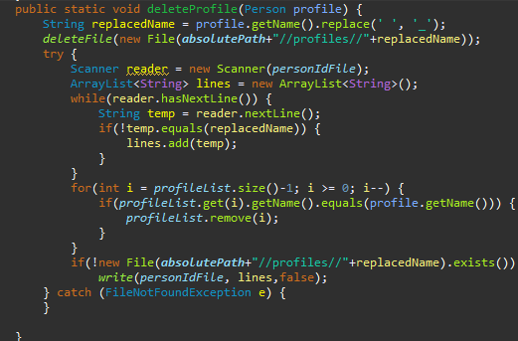
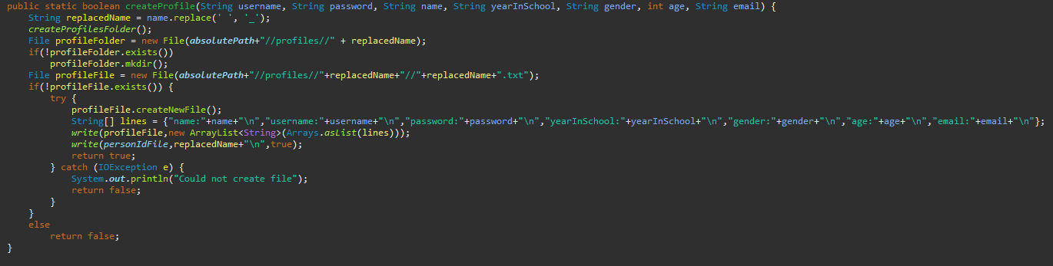

Slide 8
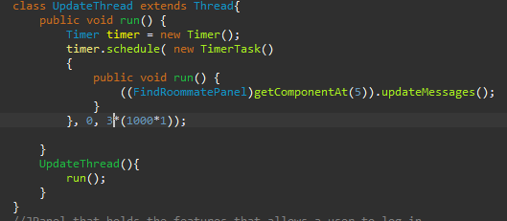
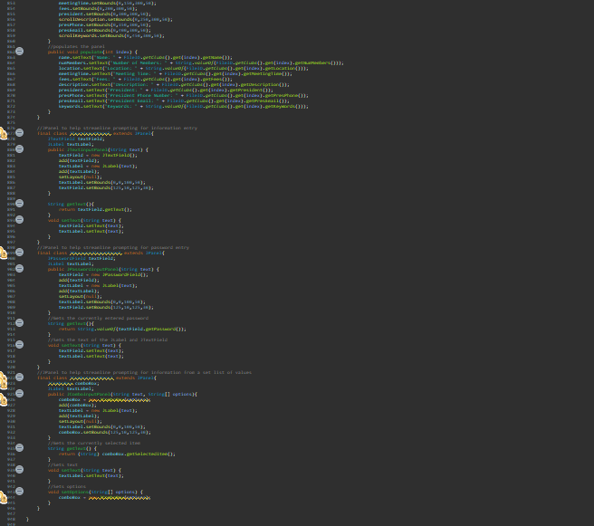
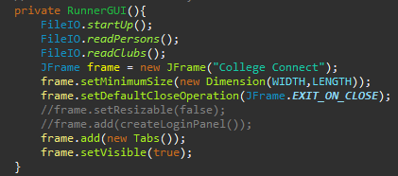
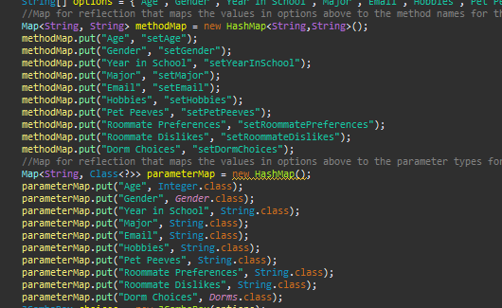

Slide 9
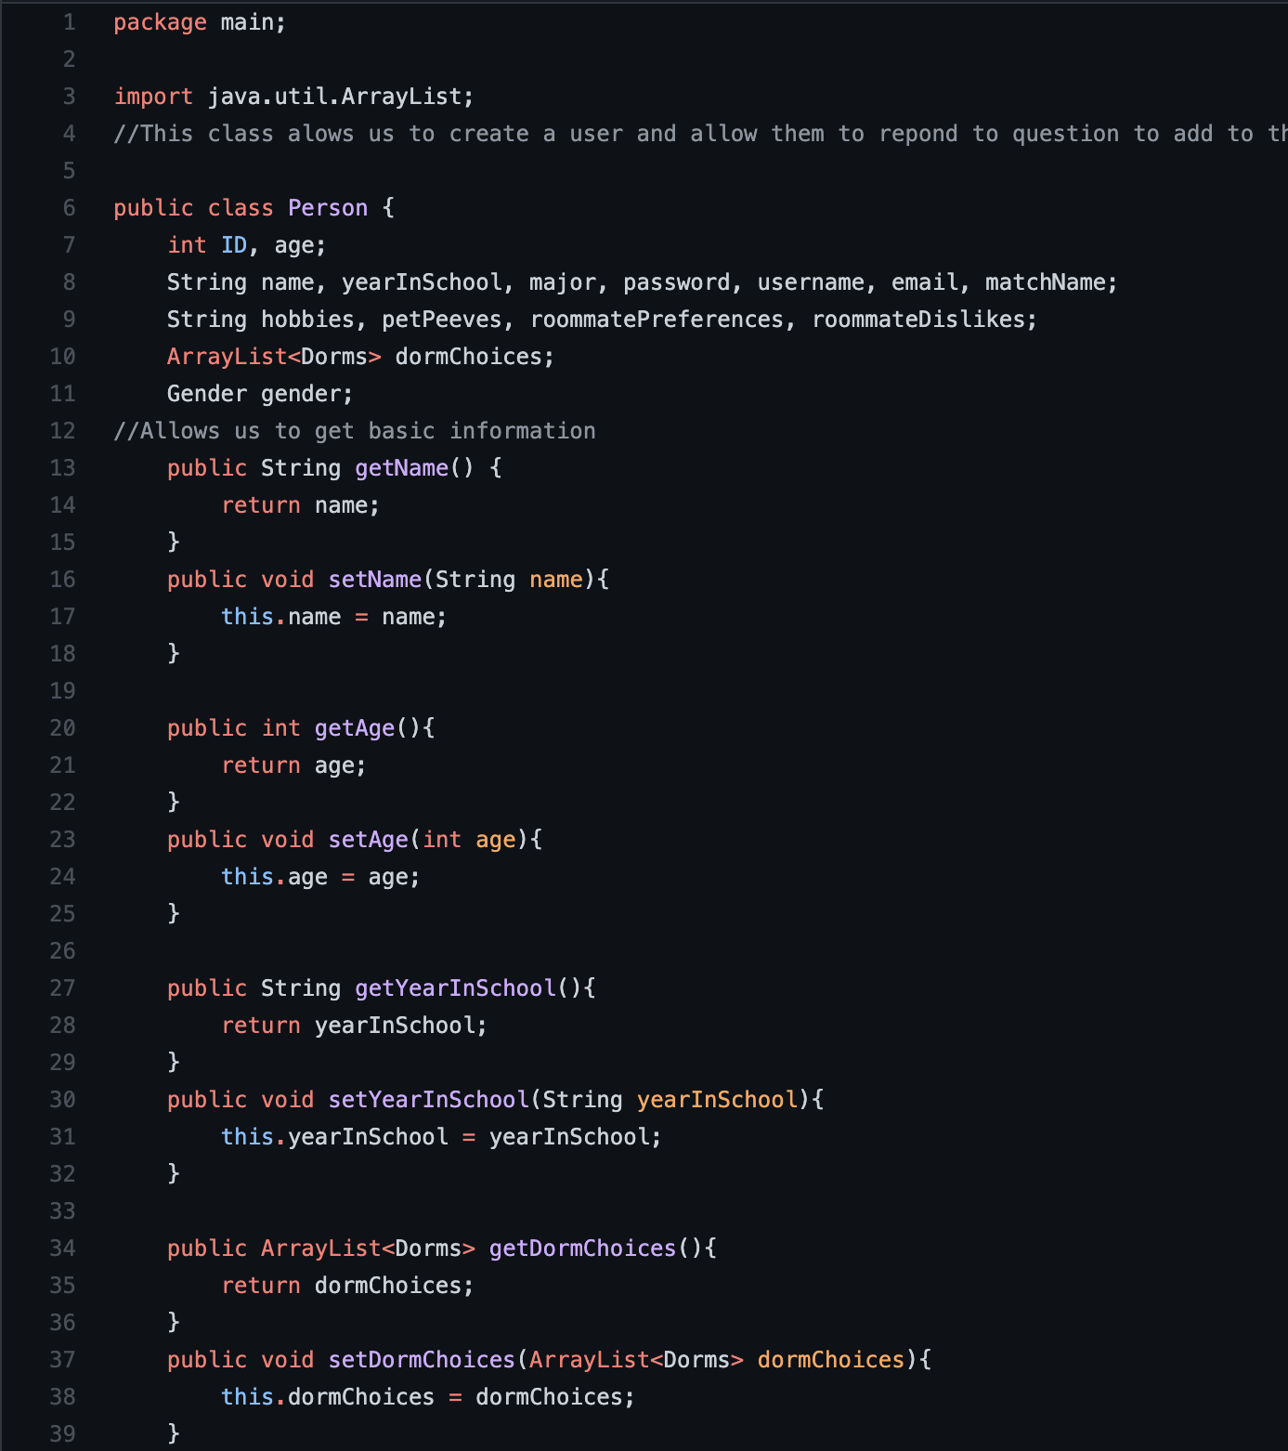
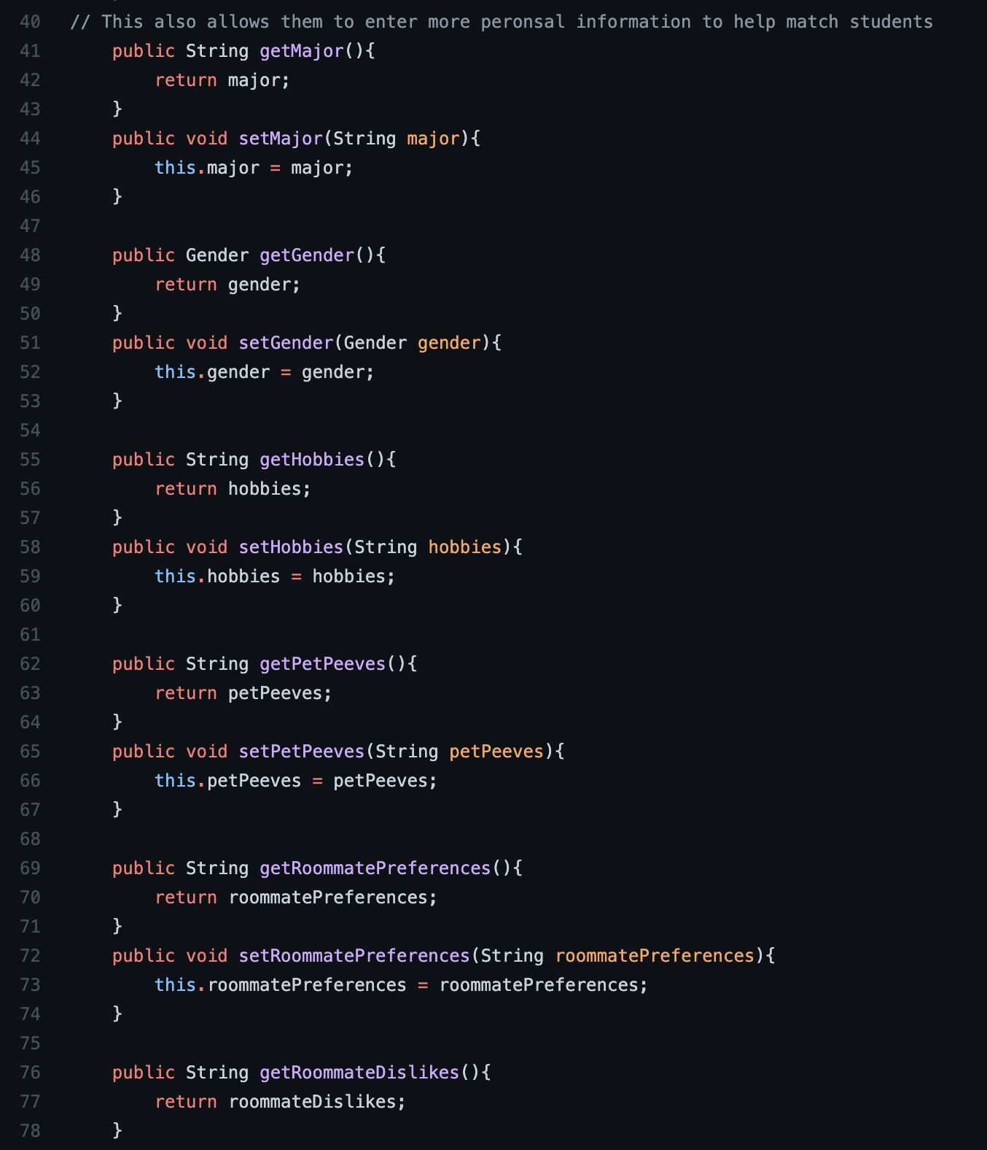
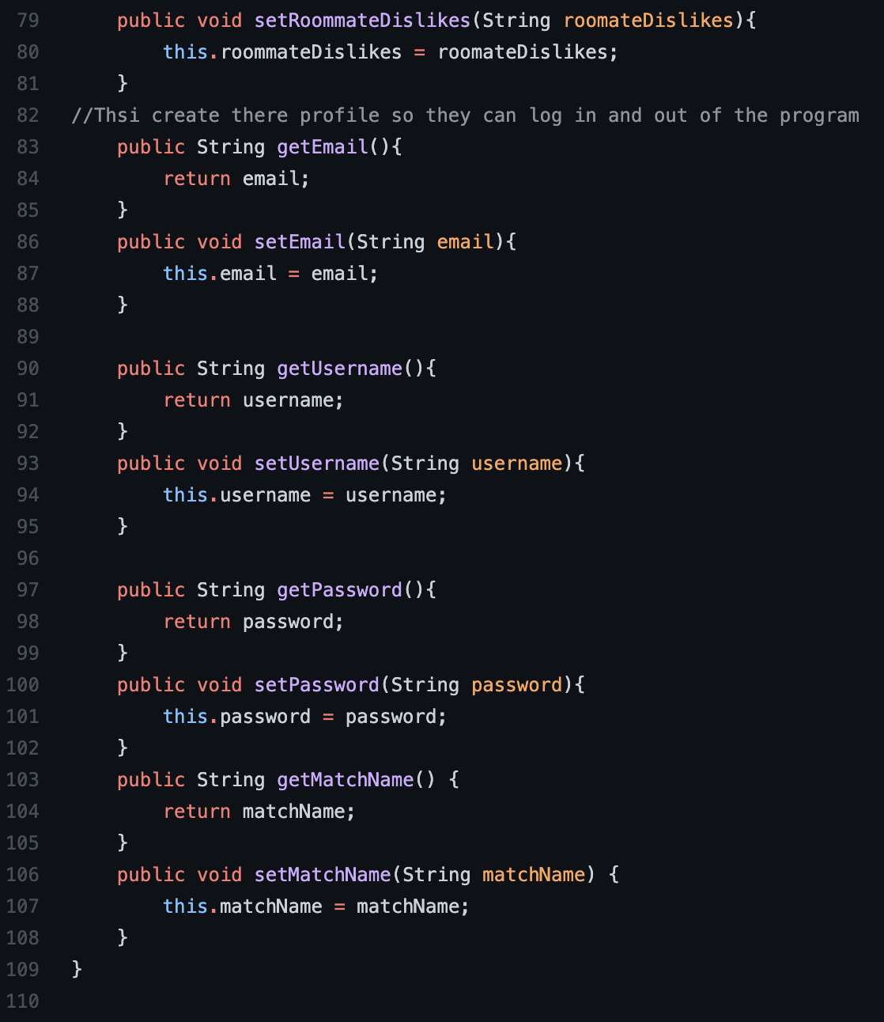
Person Class

Slide 10
Program Information
Uses 18 classes (6 outer, 12 inner)
Uses 2 Enum files (Dorms, Gender)
2435 lines of code

Slide 11
Issues
Concurrence – program saves the index of the currently logged in user
If users are created/deleted earlier in the list, this can switch the indexes, causing the program to access the wrong profiles
Solution: Save user log-in credentials or an id number and use that to access the arrayList
UI looks bad, doesn’t scale at all
When the window resolution changes, the locations of the components don’t
This creates issues as it focuses everything on the top left corner instead of the middle of the window
Solution: Revamp UI

Slide 12
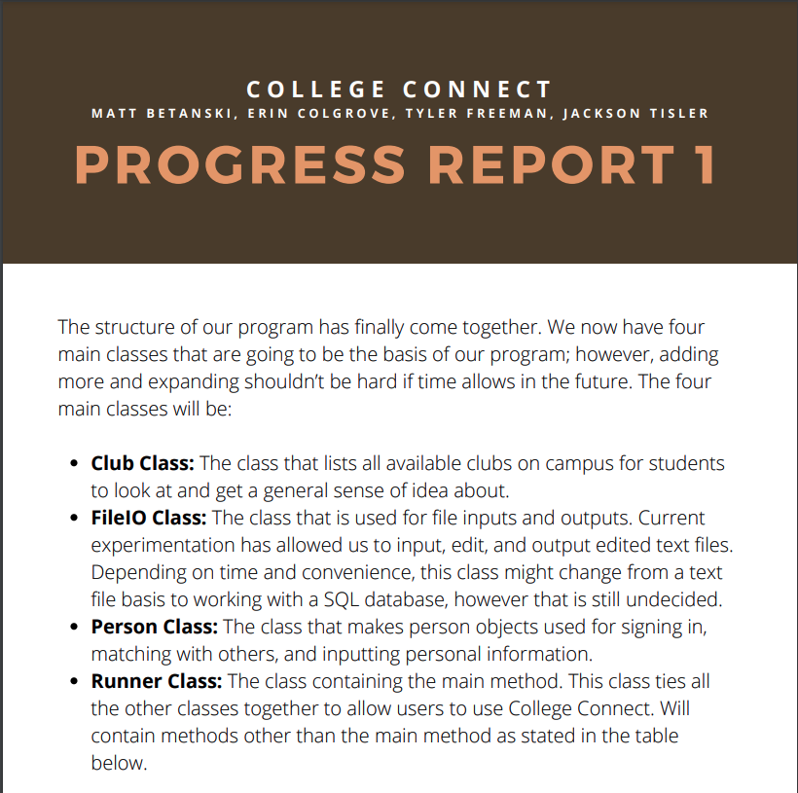
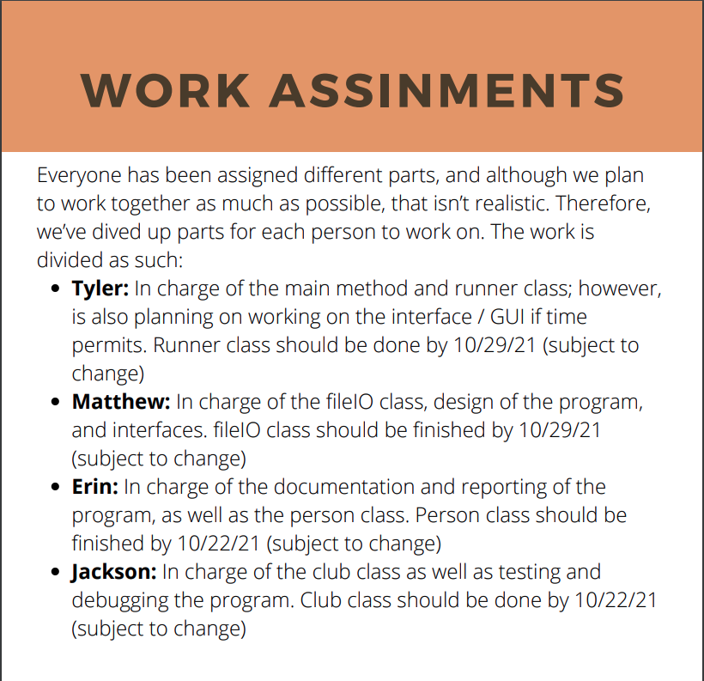
Progress Report1
Work Assignments

Slide 13
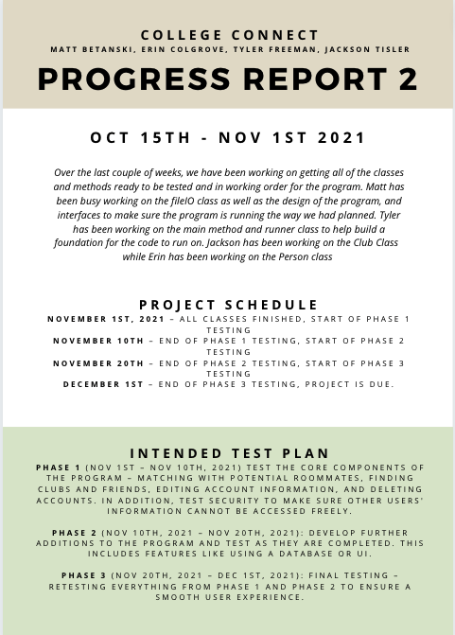
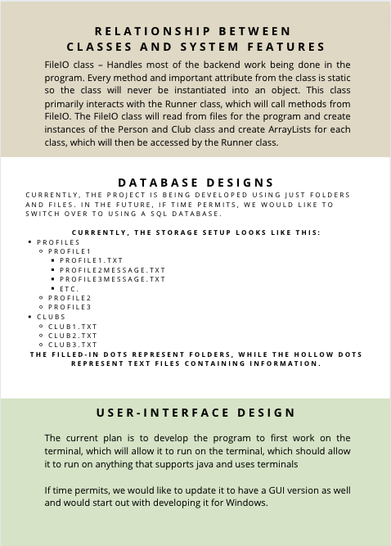
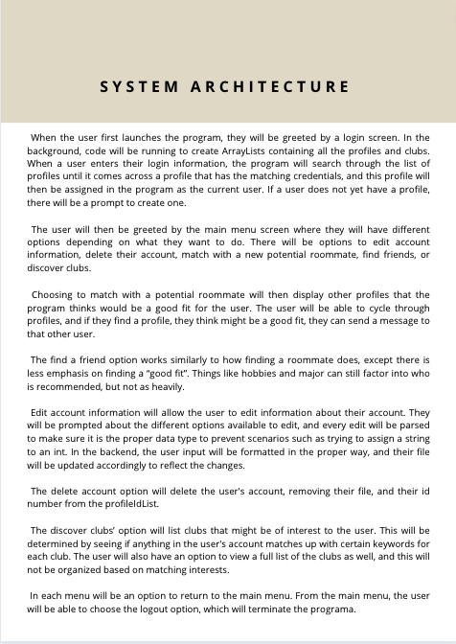
Progress Report 2

Slide 14
Future
“Points” system to help match users that have similar interests or roommate preferences/dislikes
Better messaging system
Rework parts of the program to better handle concurrence
Change file system to SQL Database
Allow a user to rename themselves
Now
Version 1.0
UI Redesign
Add Image Support
Handle null values in UI display
Mobile Applications
Website (HTML and Javascript for front-end,
Java back-end
Profanity filters

